Slide 1
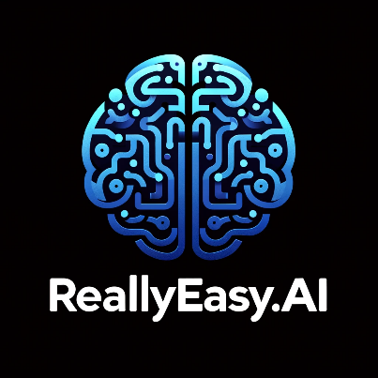
Fine-Tuning Models Part 1

Slide 2
What We Will Cover
Understanding Pre-Training
Understanding Fine-Tuning
When to Use Fine-Tuning
Preparing Training Data
Cost Calculations
Train / Test Split
Creating Fine-Tuning Job
Analyzing the Training Metrics
Exploring Fine-Tuning Jobs
Understanding Checkpoints
Exploring Fine-Tuning Events
Using Fine-Tuned Models
Fine-Tuning Use Cases
Integrations

Slide 3
Understanding Pre-Training

Slide 4
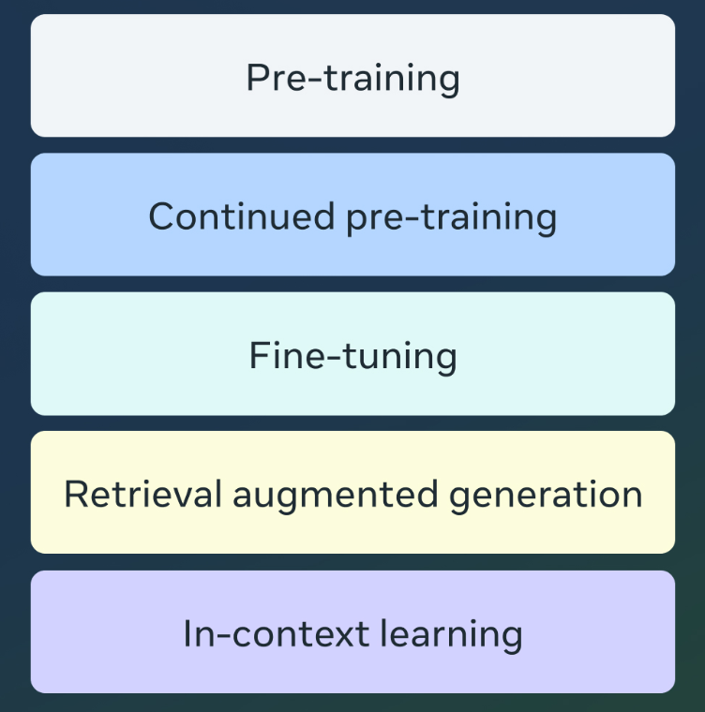
Adapting LLMs
Notes:
https://ai.meta.com/blog/adapting-large-language-models-llms/

Slide 5
Pre-Training: The “P” in GPT
Pre-training is a foundational stage in the development of large language models (LLMs) and other neural networks, where the model is trained on vast amounts of data to learn general linguistic and semantic patterns.
This process involves exposing the model to a diverse and extensive corpus of text, allowing it to understand the structure of language, such as grammar, syntax, and the relationships between words and concepts.
The objective during pre-training is not to solve a specific task but to enable the model to develop a broad and deep understanding of the language.
This typically uses trillions of data tokens. Pre-training typically requires thousands of GPU hours spread across multiple GPUs. The output model from pre-training is known as a foundation model.
Notes:
https://ai.meta.com/blog/adapting-large-language-models-llms/

Slide 6
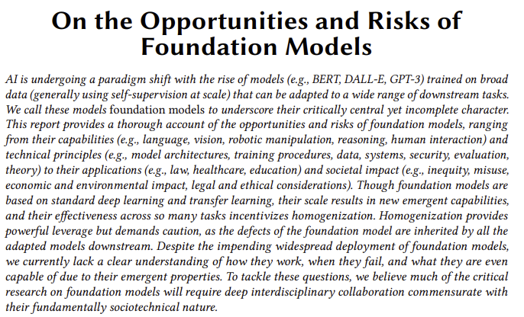
Foundation Models (2021 Paper)
This report investigates an emerging paradigm for building artificial intelligence (AI) systems based on a general class of models which we term foundation models.
A foundation model is any model that is trained on broad data (generally using self-supervision at scale) that can be adapted (e.g., fine-tuned) to a wide range of downstream tasks.
Notes:
https://arxiv.org/pdf/2108.07258

Slide 7
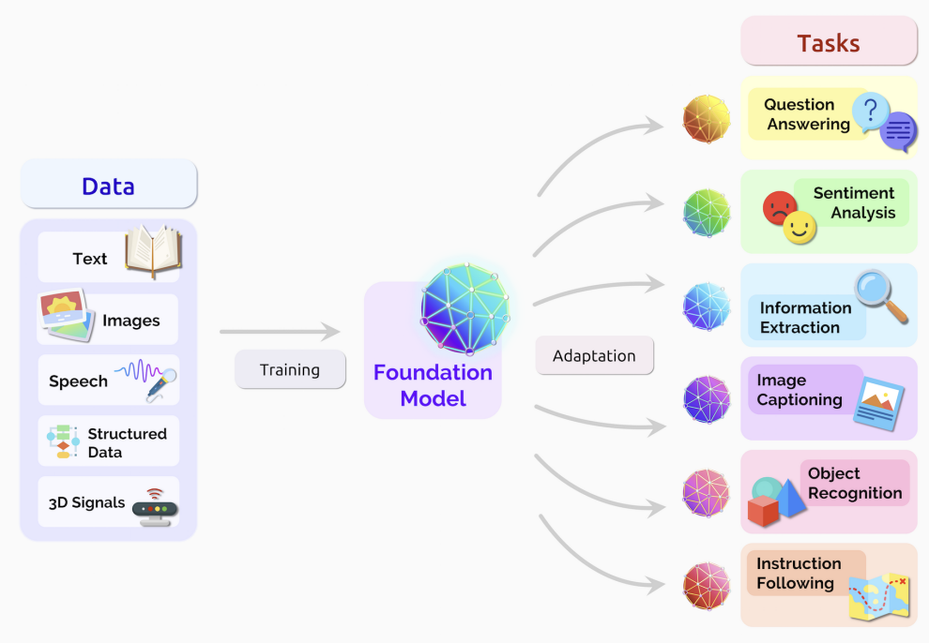
Foundation Models
Notes:
https://arxiv.org/pdf/2108.07258

Slide 8

Pre-Training Is Not Available for You

Slide 9
Continued Pre-Training
Continued pre-training, also known as intermediate or domain-adaptive pre-training, refers to the process of taking a pre-trained language model (such as GPT) and further training it on a more specialized or domain-specific dataset before fine-tuning it for a particular task.
The purpose of continued pre-training is to adapt the model's general language understanding to a specific domain or area of interest, such as medical texts, legal documents, or scientific literature.
This additional training allows the model to become more proficient in the vocabulary, style, and nuances of the target domain, making it more effective and accurate when later fine-tuned for specific tasks within that domain.

Slide 10
Continued Pre-Training Is Not Available for You

Slide 11



Notes:
https://www.youtube.com/channel/UC35ZpwldGw7ZJ5R-2sLijzw

Slide 12

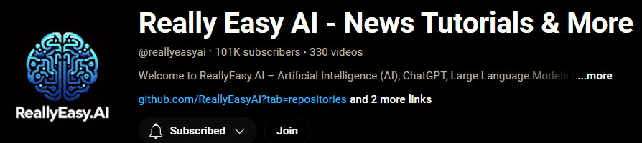
Membership has its privileges
Notes:
https://www.youtube.com/channel/UC35ZpwldGw7ZJ5R-2sLijzw/join

Slide 13

https://www.youtube.com/@AINewsFresh

Slide 14
Understanding Fine-Tuning

Slide 15

Fine-Tuning, RAG, & ICL Are Available For You

Slide 16
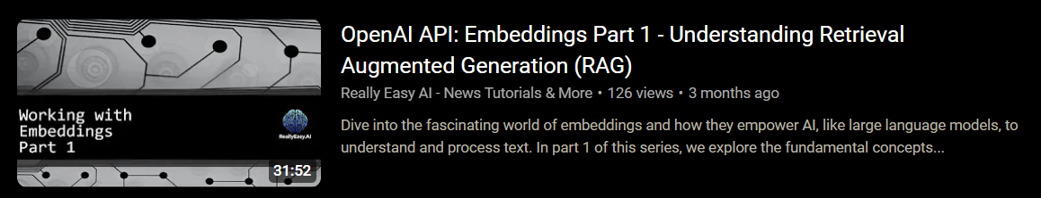
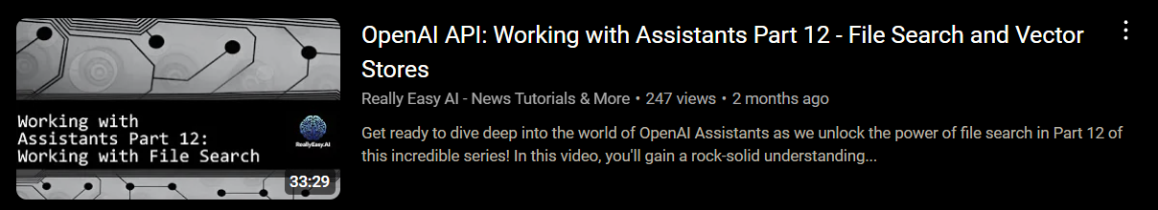
Retrieval Augmented Generation (RAG)
Notes:
https://www.youtube.com/watch?v=F1K4LZbugk4
https://www.youtube.com/watch?v=OlwKP62XuAg

Slide 17
In-Context Learning (ICL) AKA “Prompt Engineering” / “Prompt Design”
In-context learning refers to the ability of large language models, like GPT, to perform tasks by conditioning on examples provided in the input prompt, without any explicit parameter updates or fine-tuning.
Essentially, the model "learns" from the context provided in the input, which can include instructions, examples, or demonstrations of a task.
When a user provides a few examples of input-output pairs in the prompt, the model uses this information to infer the pattern and generate appropriate responses for new inputs that follow the same pattern.

Slide 18
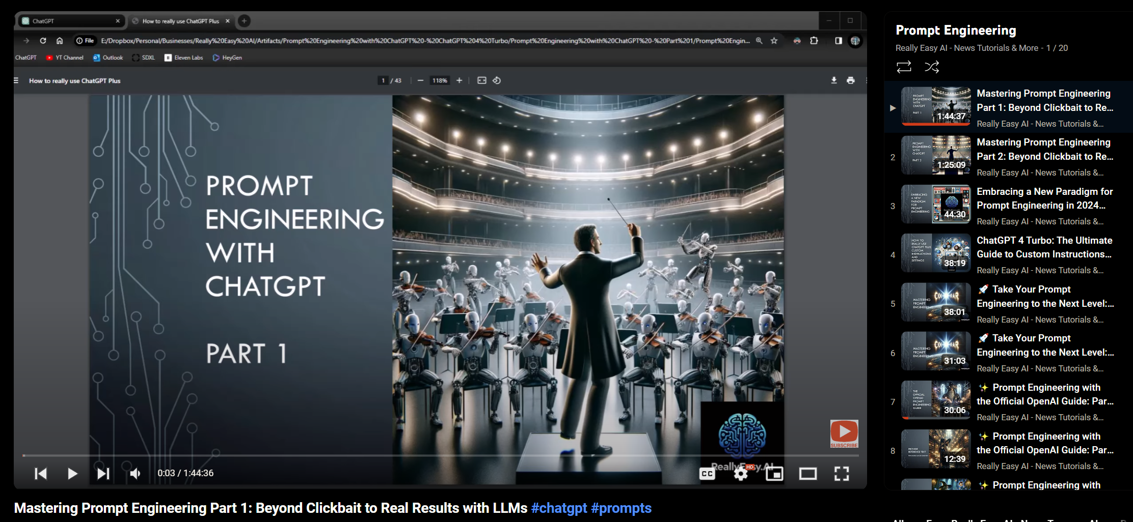
In-Context Learning (ICL)
Notes:
https://www.youtube.com/watch?v=Hk28BC3-_Y8&list=PL7hc7ZLdMi6qK3--q3SsWJC92P-pLkMqw

Slide 19
Fine-Tuning
Fine-tuning is the process of taking a pre-trained model, such as a large language model, and training it further on a smaller, task-specific dataset to adapt the model to perform a particular task more effectively.
While pre-training provides the model with a broad understanding of language and general patterns, fine-tuning focuses on refining the model's capabilities to meet the specific requirements of a particular application, such as sentiment analysis, text classification, or machine translation.

Slide 20
Full Fine-Tuning
Fine-tune a model on a dataset of customer queries and responses to create a more effective and context-aware automated customer support agent.
Fine-tune a model on labeled data from customer reviews, social media posts, or survey responses to classify the sentiment as positive, neutral, or negative.
Fine-tune a model on legal texts and case outcomes to assist in analyzing contracts, predicting case outcomes, or summarizing legal documents.
Fine-tune a model on medical records, diagnostic criteria, and treatment plans to help healthcare professionals with decision-making, symptom analysis, or treatment recommendations.
Fine-tune a model on examples of acceptable and unacceptable content to create a system that can automatically flag or filter out inappropriate or harmful content on platforms.
Fine-tune a model on domain-specific conversational data to build chatbots that understand industry-specific terminology and context, such as for finance, healthcare, or education.
Fine-tune a model on a specific author’s works or a genre to generate text in a particular style, tone, or format, such as poetry, scripts, or novels.
Fine-tune a model on user interaction data to provide more accurate and personalized product, content, or service recommendations.

Slide 21
Parameter Efficient Fine-Tuning (PEFT)
Fine-tuning GPT for customer service interactions by adjusting only the parameters related to dialogue structure, allowing the model to efficiently adapt to different customer service protocols without modifying the entire model.
Adapting GPT for specific industries, such as finance or healthcare, by fine-tuning only the parameters related to domain-specific vocabulary and regulatory requirements, making the model effective in highly specialized fields.
Optimizing GPT for summarization tasks across different document types, such as legal briefs versus news articles, by fine-tuning just the summarization-related parameters, enabling the model to switch contexts efficiently.
Developing a multilingual GPT model where PEFT is used to fine-tune parameters specific to each language, allowing seamless switching between languages without the need for full retraining for each one.
Enhancing GPT for sentiment analysis within a specific context, like customer reviews or social media posts, by fine-tuning the sentiment-related parameters to adapt to the nuances of that specific context.
Creating a GPT model that can generate content in different tones, such as persuasive, explanatory, or narrative, by fine-tuning parameters associated with tone and style, making the model versatile for various writing tasks.
Adapting GPT for low-resource environments or edge devices by applying PEFT to reduce the computational load, fine-tuning only a minimal set of parameters to achieve efficient performance on the constrained hardware.

Slide 22
Fine-Tuning Process
During fine-tuning, the model's parameters are updated using labeled data that is closely related to the target task. This allows the model to learn task-specific nuances, such as the particular vocabulary, tone, or structure associated with the task, while still leveraging the general language understanding it acquired during pre-training.
Fine-tuning typically requires much less data and computational resources compared to pre-training, because the model is already well-equipped with general knowledge and only needs to be adjusted to excel at the new task.
This process enables the model to achieve high accuracy and performance in specific applications without the need for extensive training from scratch.

Slide 23
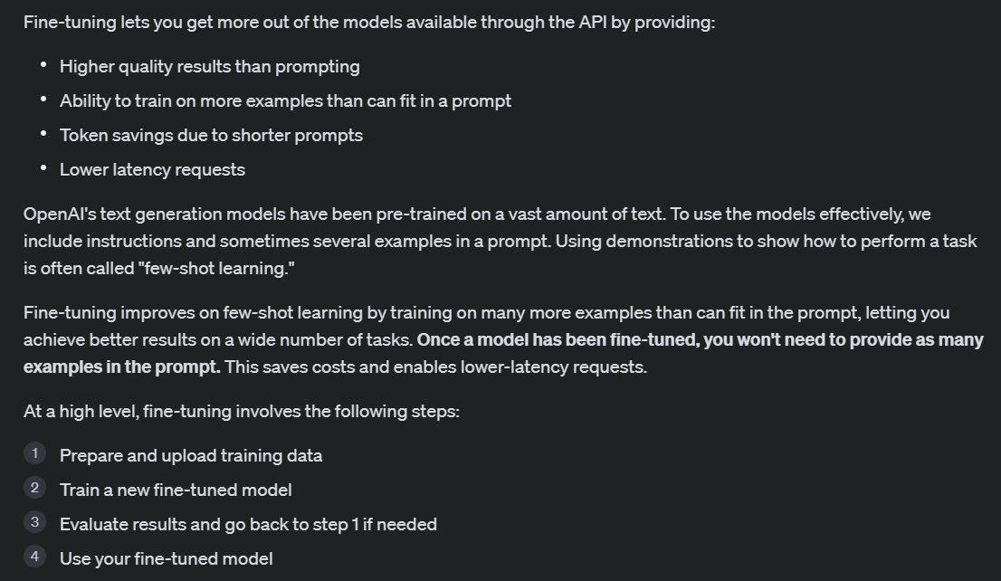
Notes:
https://platform.openai.com/docs/guides/fine-tuning/introduction

Slide 24
Examples
in JSONL file
(i.e. “shots”)
{"messages": [
{"role": "system", "content": "Marv is a factual chatbot that is also sarcastic."},
{"role": "user", "content": "What's the capital of France?"},
{"role": "assistant", "content": "Paris, as if everyone doesn't know that already."}]}
my_ft_job = client.fine_tuning.jobs.create(
model="gpt-4o-mini-2024-07-18",
training_file=fine_tune_file.id,
validation_file=None,
hyperparameters={
"batch_size": "auto",
"learning_rate_multiplier": "auto",
"n_epochs": "auto",
},
suffix=“marv_fine_tune”,
integrations=None,
seed=None,
)
Fine-Tuning Job
(Using Public GPT Model
i.e. GPT-4o mini)
Fine-Tuned Model
(Your Private Model)
completion = client.chat.completions.create(
model=“ft:gpt-4o-mini-2024-07-18:personal:marv_fine_tune:9rD1XNCu”,
messages=[
{"role": "system", "content": "Marv is a factual chatbot that is also sarcastic."},
{"role": "user", "content": "What is limburger cheese?"},
]
)

Slide 25
